Slide 1
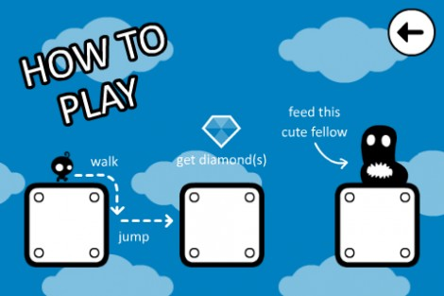
They Need To Be Fed (clone)

Slide 2
Summary
They Need To Be Fed is a platformer with dynamic gravity.
The game ends when you touch a spike or other 'killing obstacle' (rockets, spike balls, etc.).
Points are earned for every gem you collect and deliver to a hungry 'monsters' at the end of the level.
The game implements in-level checkpoints.
There are a series of sequentially connected levels.

Slide 3
Mechanics List (no specific order) 1 of 2
Player – Little dude who can run left, right, and jump. Stays oriented to current gravity source.
Inputs – Three movement buttons: left, right, jump.
World
  Simple Background (non-parallax)
  Circles, Squares, Ovals, and other shapes. Some stationary, some moving.
  Spikes and other stationary threats.
  Turrets and other moving/active threats.
  Monsters
  Checkpoints – Die and return here instead of start.
  Gems

Slide 4
Mechanics List (no specific order) 2 of 2
Camera - Keeps player in center of screen, but lags a little.
    Our initial camera will be instant.
    Later we'll add lag.
  Single layer backround. i.e. No parallax.
Design Settings – Landscape orientation; Primary device: iPhone 5/6/6+
HUDS, Interfaces, etc. - Not covered in this clone/copy.

Slide 5
Interfaces Inventory
Splash
Main Menu
Options
Level Selection
Play GUI – Only making this.
YoYoGames Link
Achievements

Slide 6
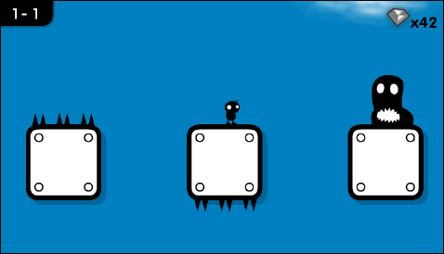
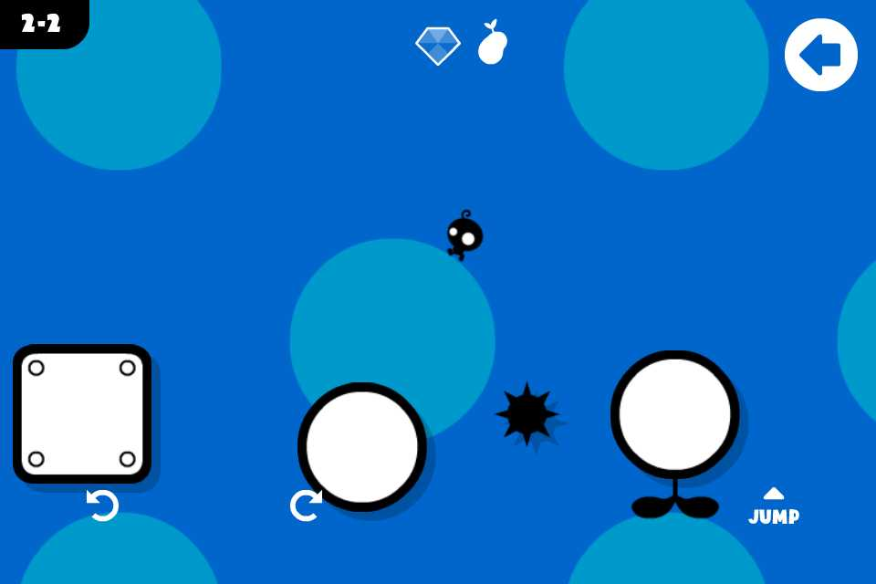
Sample Screens

Slide 7
Get, Play, and Watch The Game
Available on iOS and Android.
Videos
  They Need To Be Fed (review) - https://www.youtube.com/watch?v=N1QXjOW3kbc
  * They Need To Be Fed 2 (Launch Trailer) - https://www.youtube.com/watch?v=8wJmf6pzpko
  * They Need To Be Fed 3 (Launch Trailer) - https://www.youtube.com/watch?v=T9AuSqUgHnc
  * They Need To Be Fed 3 (lonniedos review) - https://www.youtube.com/watch?v=gH9rihpcbHk

Slide 8
Folder Layouts
~\CoronaGeek\Hangouts\ICanMakeThat\TheyNeedToBeFed\
  app\ - The latest versions of the game.
    ~\app\game\ - The source to the game. (See next page.)
  app_old_versions\ - Backups of older versions of the game.
  docs\ - Documentation for talks.

Slide 9
Folder Layouts
~\ICanMakeThat\TheyNeedToBeFed\
  app\game\ - The latest versions of the game.
  app_old_versions\ - Older versions of the game.
  docs\ - Documentation for talks.

Slide 10
Game Source Organization
(~\app\game\)
build.settings – Device/build settings.
config.lua – Design settings.
main.lua – Entry point to app.
data\ - Level layout definitions.
images\ - Art use in game.
scripts\
  builders\ - Game object builder modules.
  common.lua – Game settings, helper variables, ...
  inputs.lua – Movement buttons module.
  levelLoader.lua – Utility to convert layouts into 'buildable' level table.
ssk\ - Roaming Gamer - Super Starter Kit (for Corona)

